Slide 1
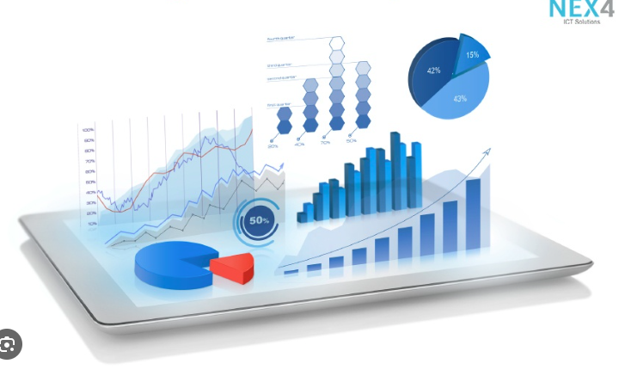




Data Visualization
in Power BI
01 Chart Basics
Prepared By :
Said Fawzy
Manager of Information Center
Tendering Department
Arab Contractors

Slide 2

1
What are visualizations?
2
Introduction to the Report Editor
3
Column and Bar Charts
4
Pie and Donut Charts

Slide 3
5
Line and Area Charts
6
Area Chart
7
Table Visualization

Slide 4
1
What are visualizations?

Slide 5





Slide 6
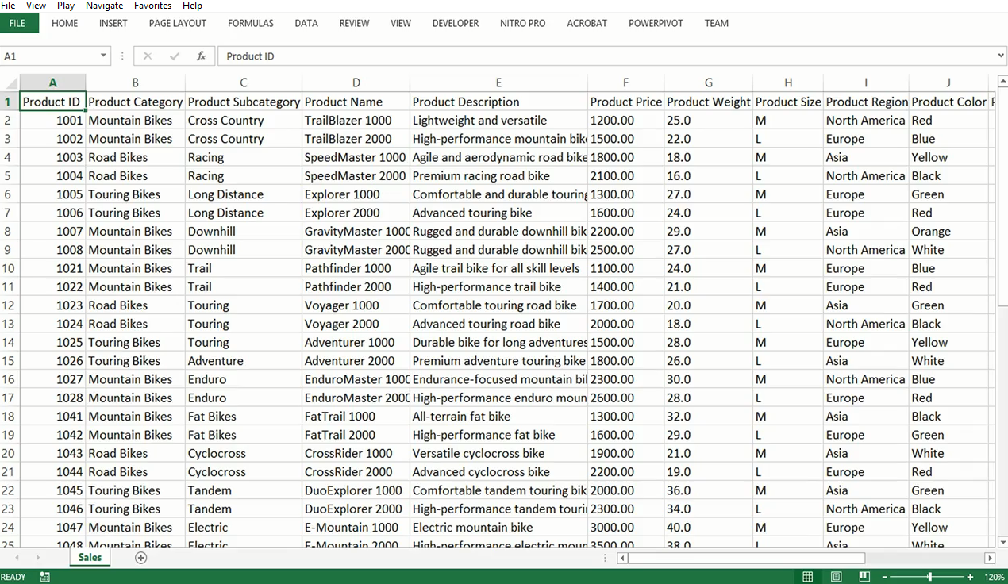
Data Comes in a Complex way and hard to digest

Slide 7
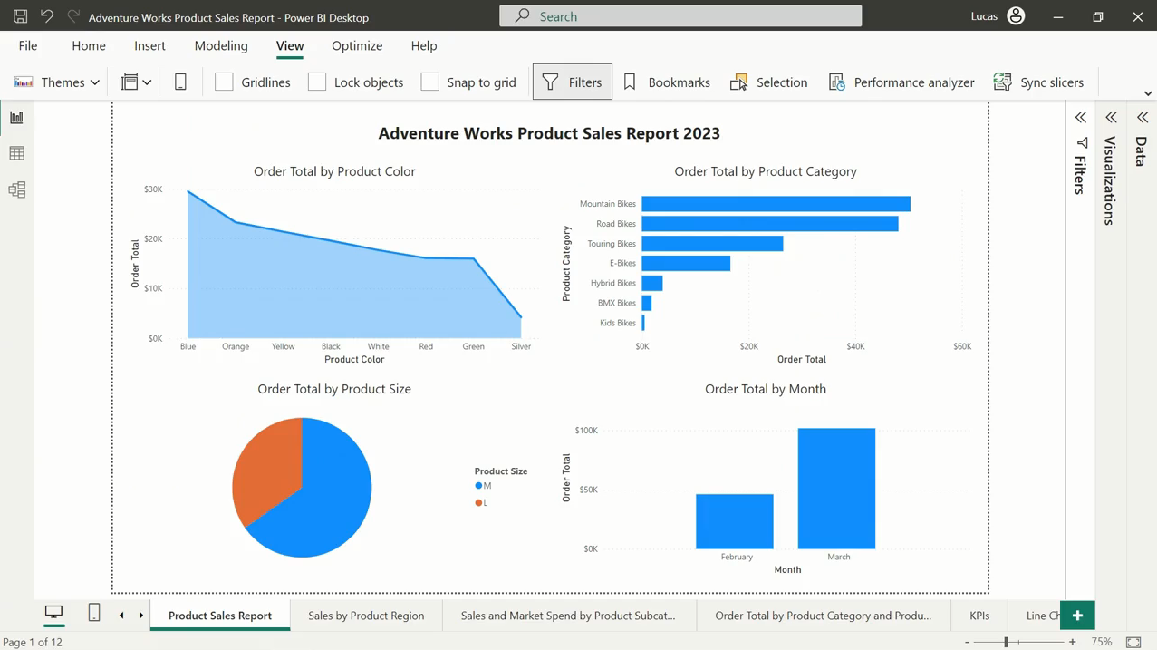
You can visualize data
to transform the data into
a compelling, interactive, and easily digestible format

Slide 8
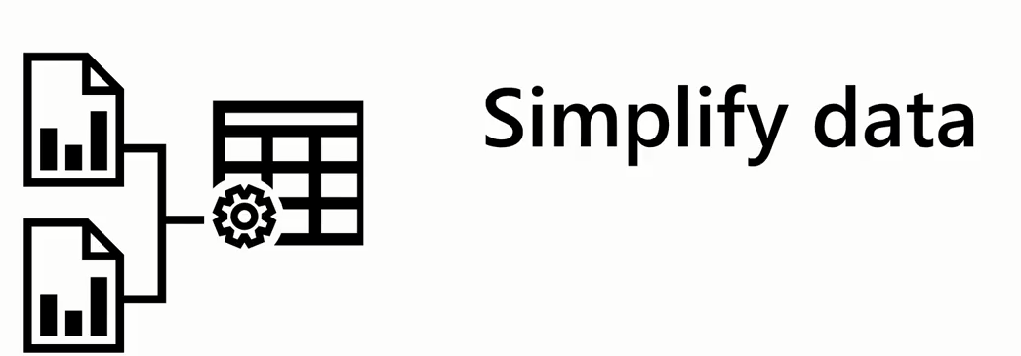

How data visualization can enhance business intelligence

Slide 9
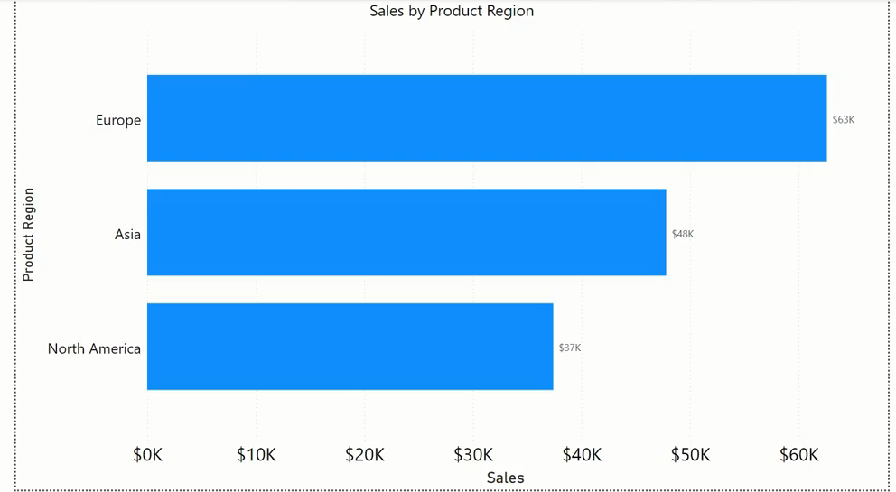
How data visualization can enhance business intelligence

Slide 10
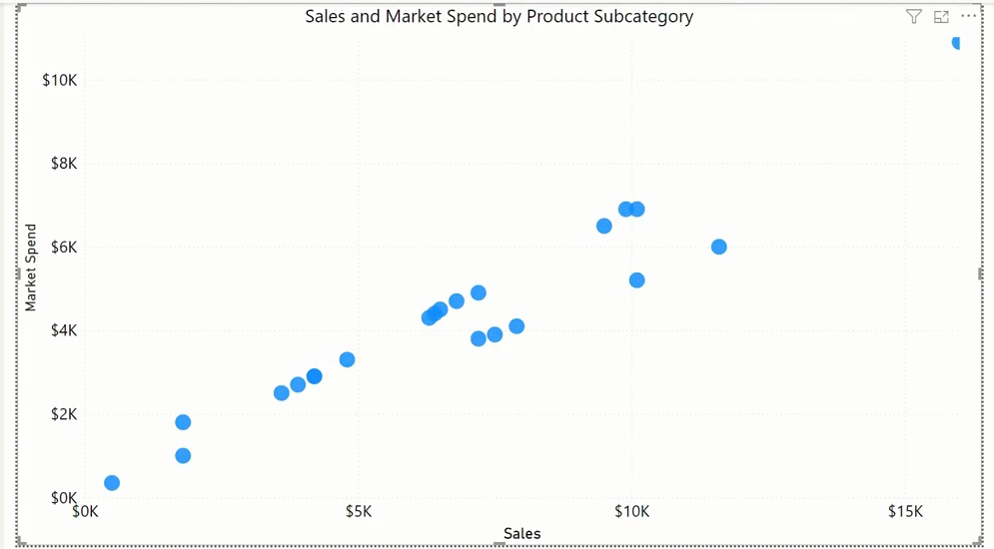
How data visualization can enhance business intelligence

Slide 11
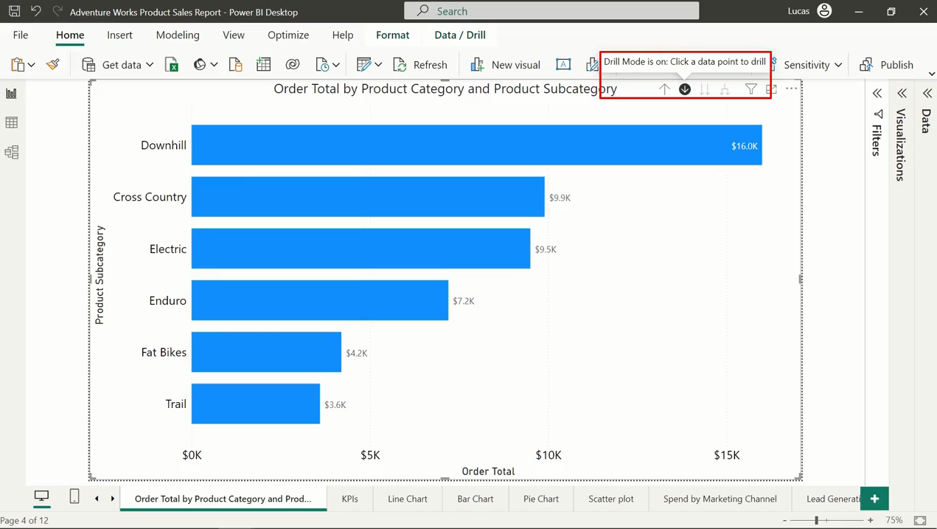
How data visualization can enhance business intelligence
Drill down data

Slide 12


How data visualization can enhance business intelligence

Slide 13

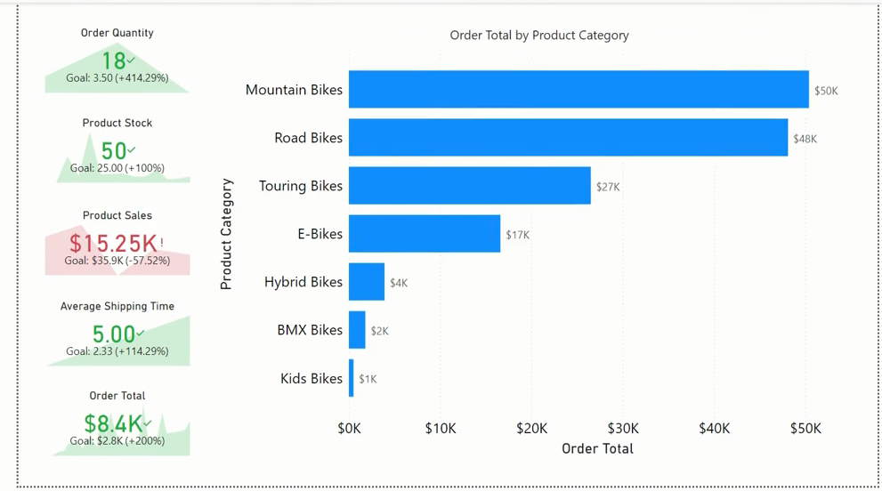
How data visualization can enhance business intelligence

Slide 14
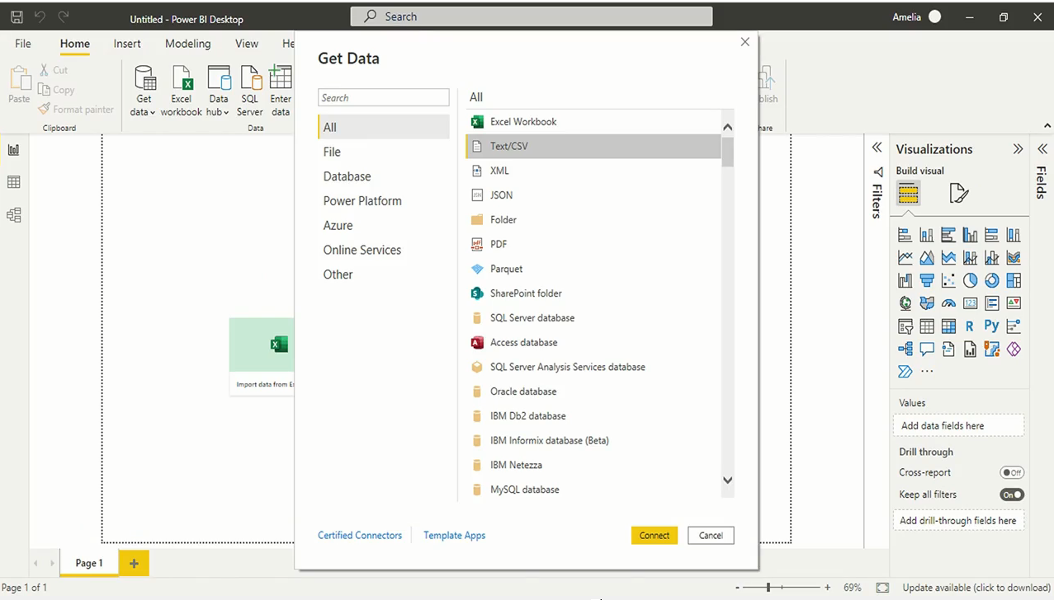
Creating visualizations in Power BI
Starts with connecting to data

Slide 15

Creating visualizations in Power BI

Slide 16
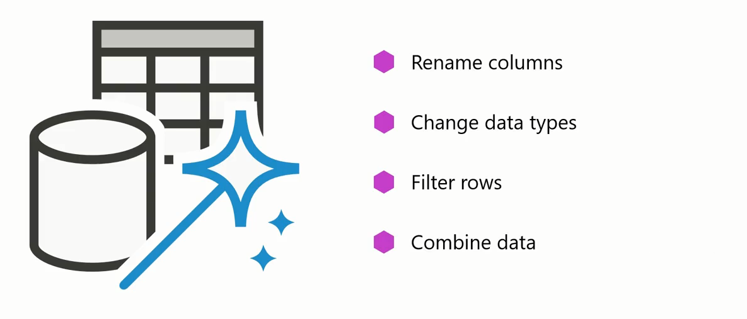
Creating visualizations in Power BI

Slide 17
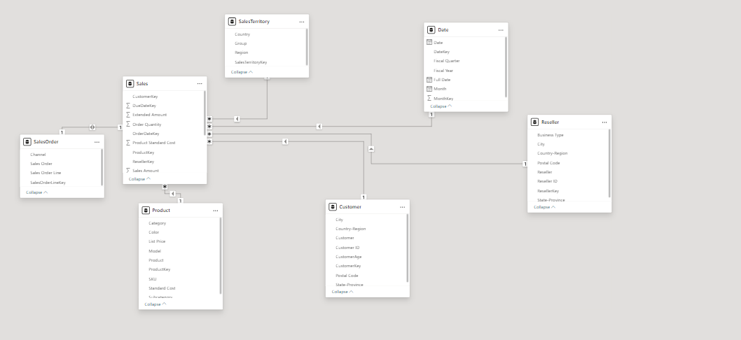
Creating visualizations in Power BI
Data Modeling and Using DAX

Slide 18
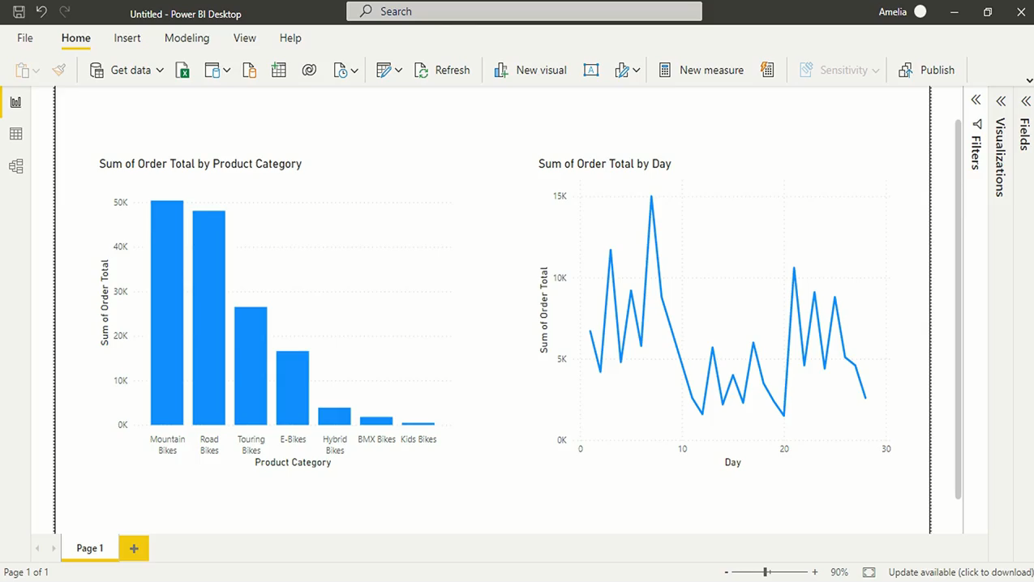
Creating visualizations in Power BI
Visualizing Data

Slide 19

Creating visualizations in Power BI

Slide 20
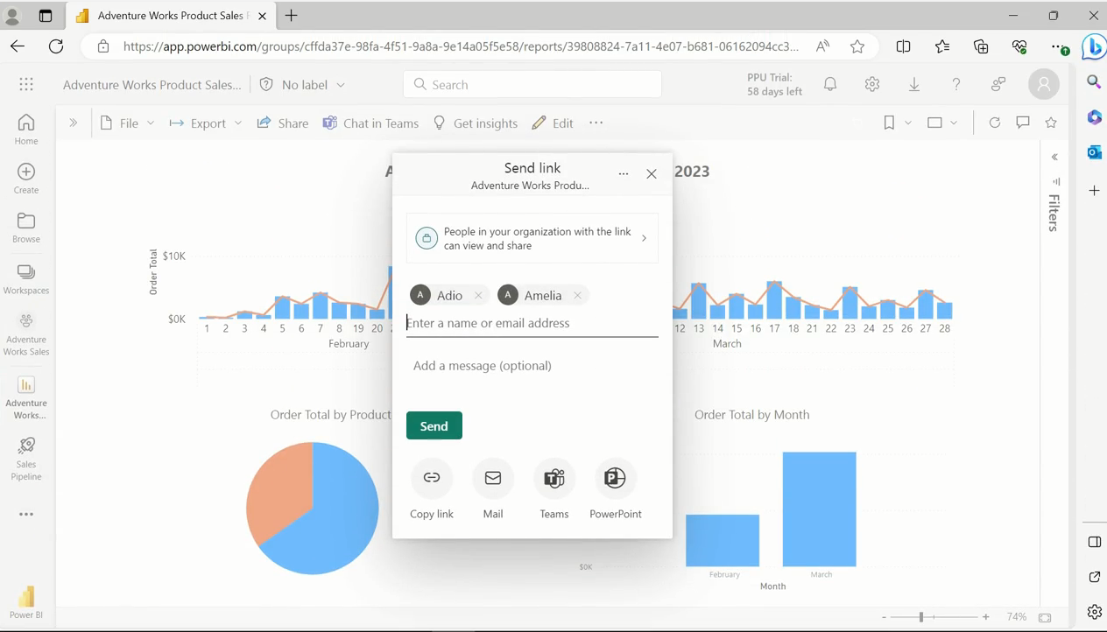
Creating visualizations in Power BI
Publish and share report

Slide 21
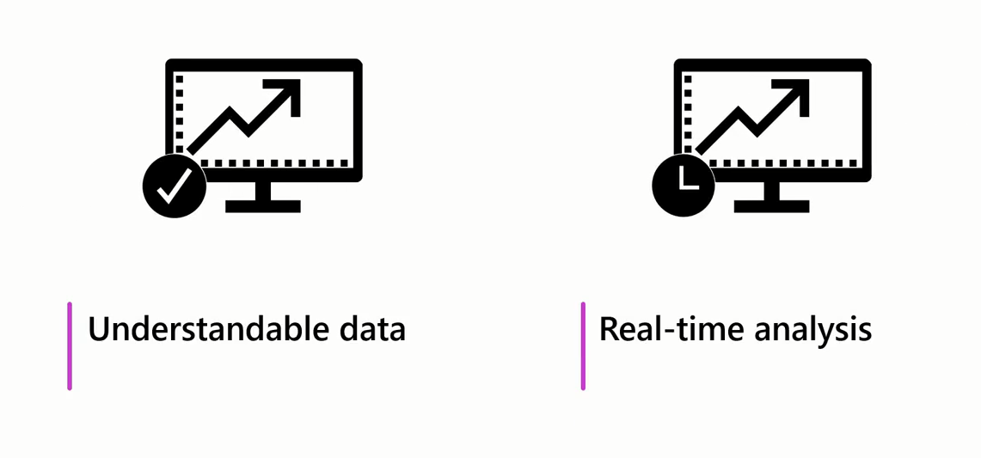
Creating visualizations in Power BI

Slide 22
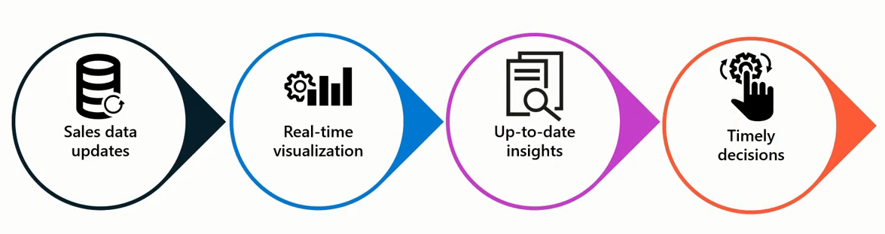

Creating visualizations in Power BI

Slide 23

Choose The Right Visual

Slide 24
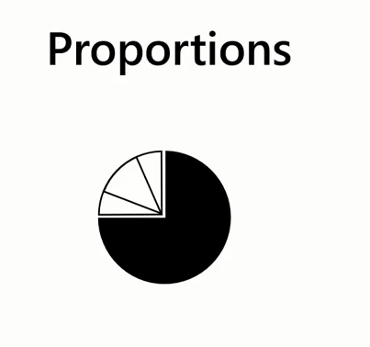
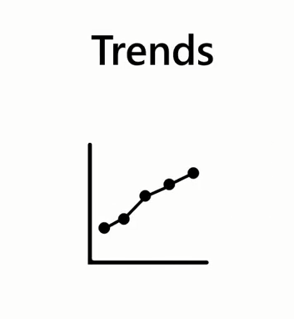
Choose The Right Visual

Slide 25

Choose The Right Visual

Slide 26
Question
What is the fundamental role of data visualization in the field of Business Intelligence?
To eliminate the need for data analysis
To transform complex data into understandable insights
To improve the visual appeal of data reports
To replace raw data

Slide 27
ANSWER
What is the fundamental role of data visualization in the field of Business Intelligence?
To eliminate the need for data analysis
To transform complex data into understandable insights
To improve the visual appeal of data reports
To replace raw data

Slide 28
2
Introduction to the Report Editor

Slide 29
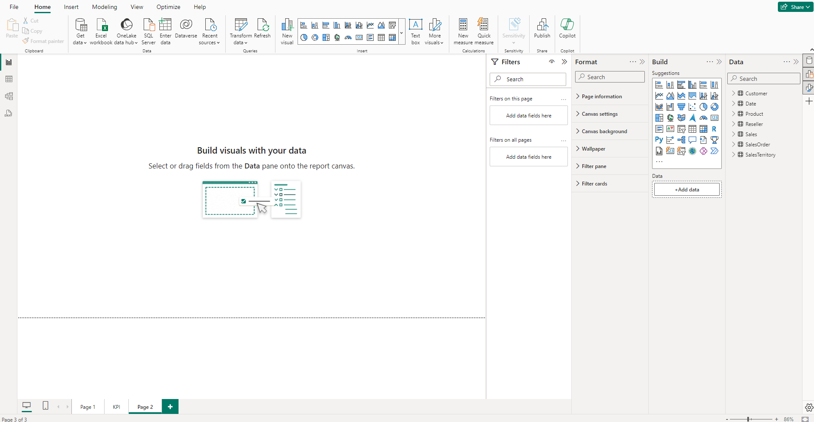
Introduction to the Report Editor
This is where you'll spend most of your time converting raw data into meaningful visual stories.

Slide 30
Introduction to the Report Editor
Ribbon
The Ribbon is where you have all your high-level command options

Slide 31
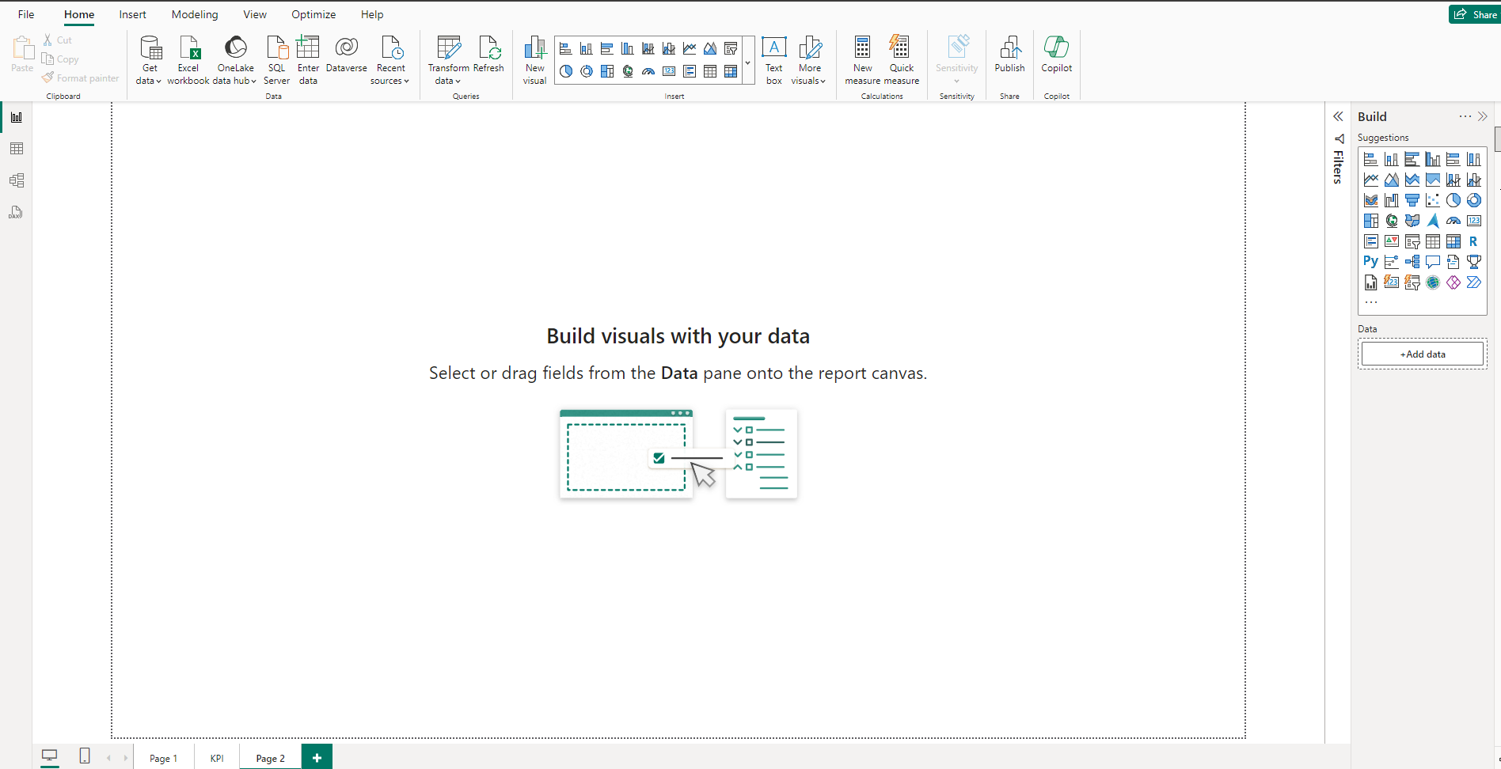
Introduction to the Report Editor
Report Canvas
The Report Canvas is your stage; this is where your performance happens.
All the dragging and dropping of fields and visuals you do end up here.

Slide 32
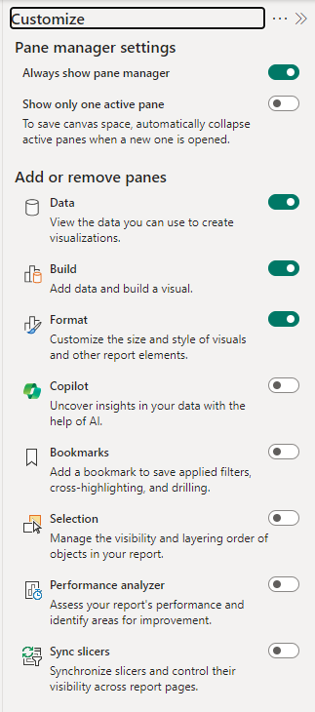
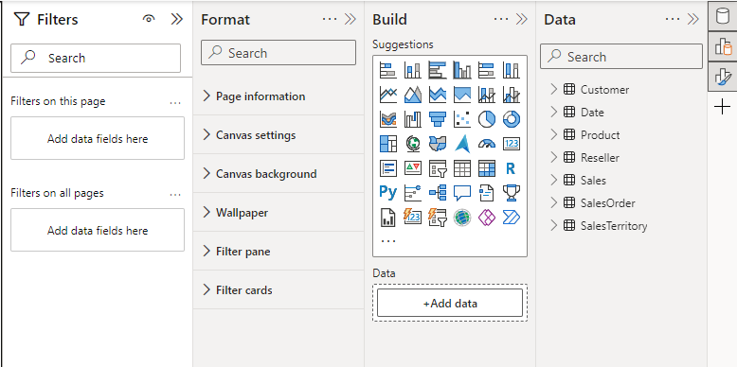
Introduction to the Report Editor
Report Editor panes

Slide 33
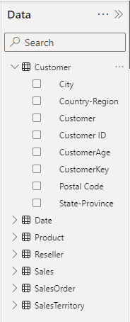
Introduction to the Report Editor
Data pane
When you load data into Power BI, those data fields appear in the Data pane on the right-hand side of your screen.

Slide 34
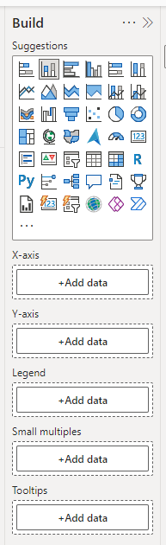
Introduction to the Report Editor
Build pane
Is where you choose your visual and add fields to build.

Slide 35
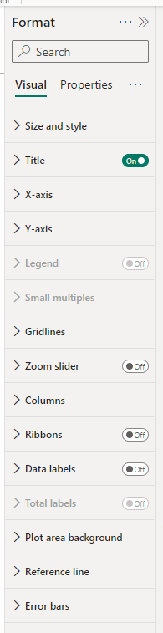
Introduction to the Report Editor
Format pane
It is where you format your visuals and set properties.

Slide 36
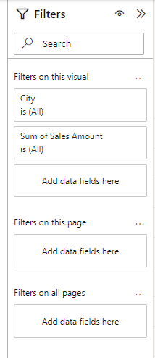
Introduction to the Report Editor
Filter pane
It is where you can filter your Visual , Page or entire report to get specific data.

Slide 37
3
Column and Bar Charts

Slide 38
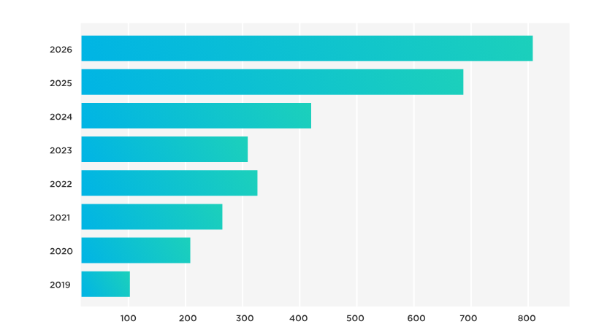
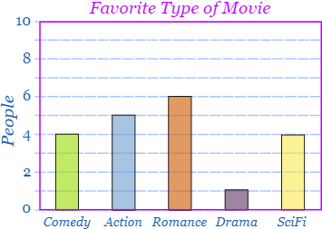
Bar and Column Charts
Bar and column charts are popular types of visualizations to display data in a clear and organized way.
They are beneficial for showcasing categorical data or data that can be organized into distinct groups.

Slide 39
Bar and Column Charts
Bar charts display data horizontally, whereas column charts display data vertically.

Slide 40
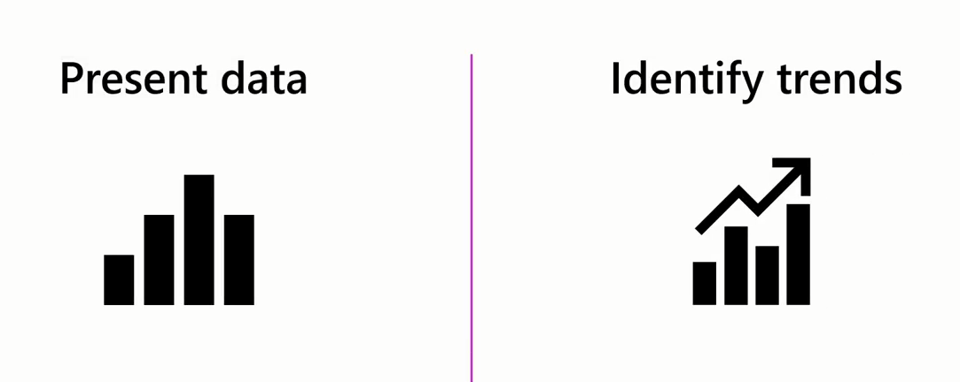
Bar and Column Charts
The simplicity and intuitive nature of bar and column charts make them effective tools for presenting data and identifying patterns or trends over time.

Slide 41
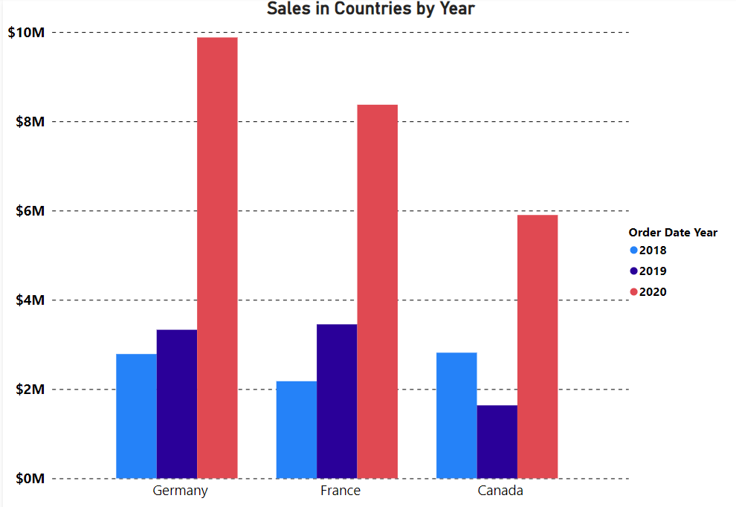
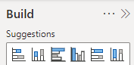
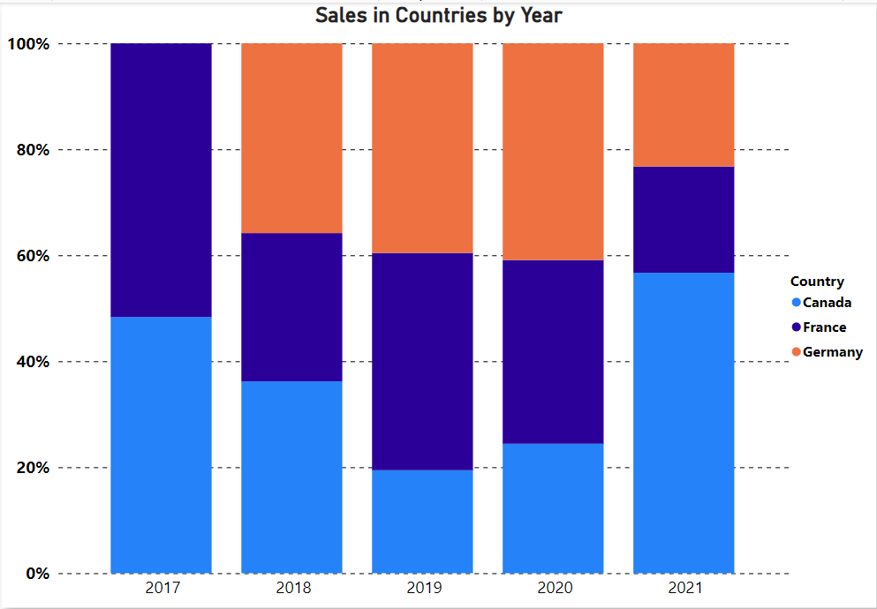
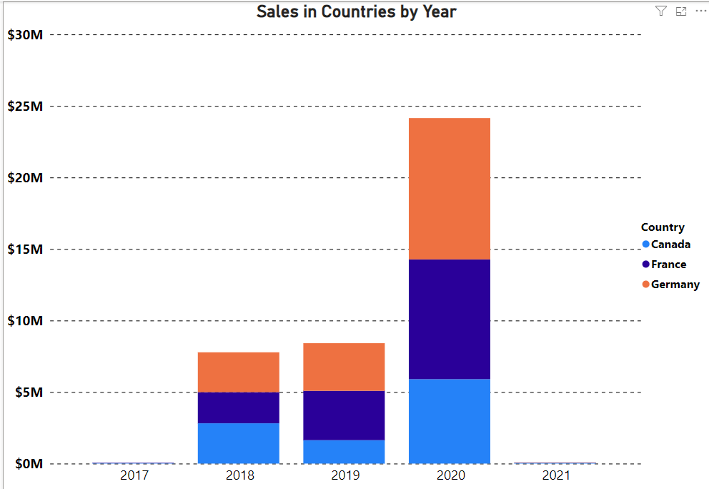
6 Types of Bar and Column Charts
Clustered
Stacked
100% Stacked

Slide 42
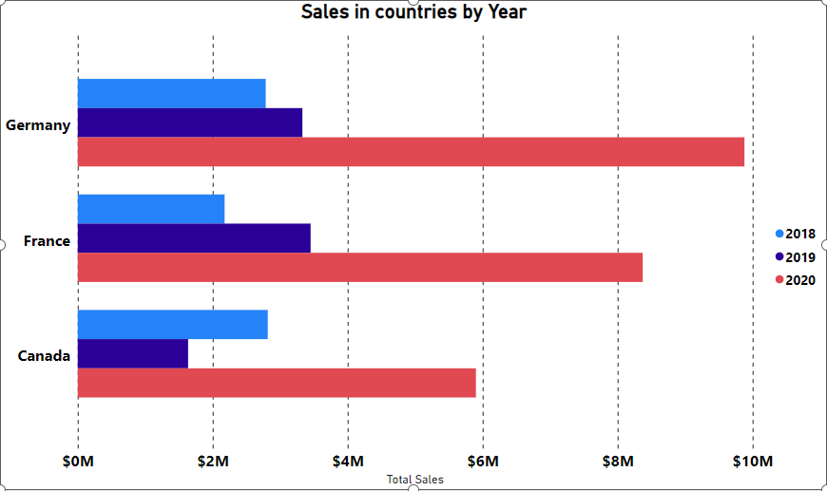
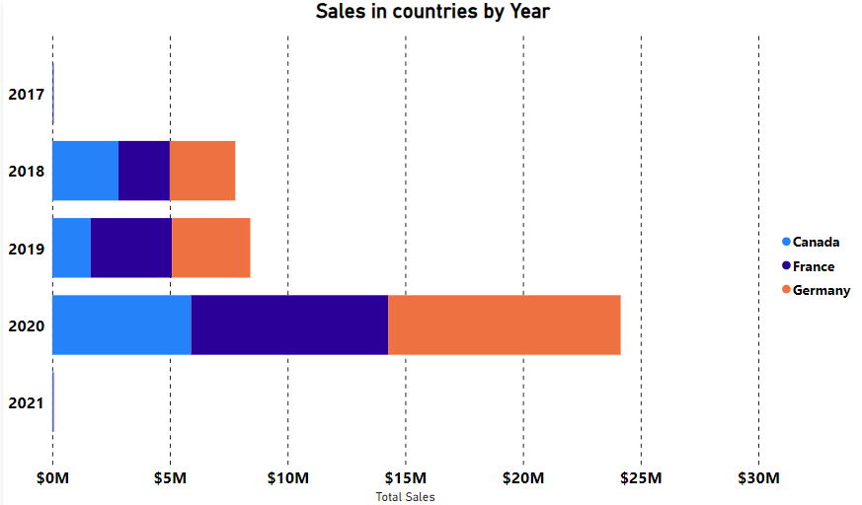
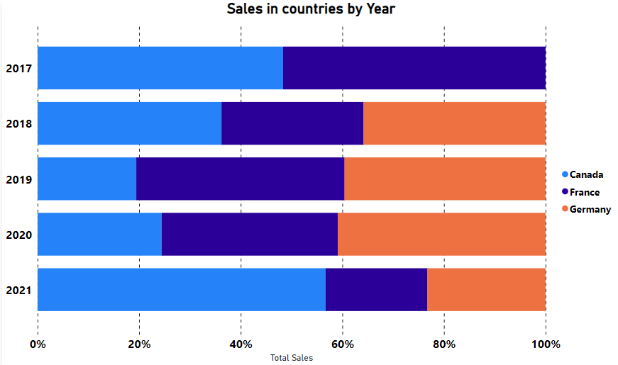
6 Types of Bar and Column Charts
Clustered
Stacked
100% Stacked

Slide 43
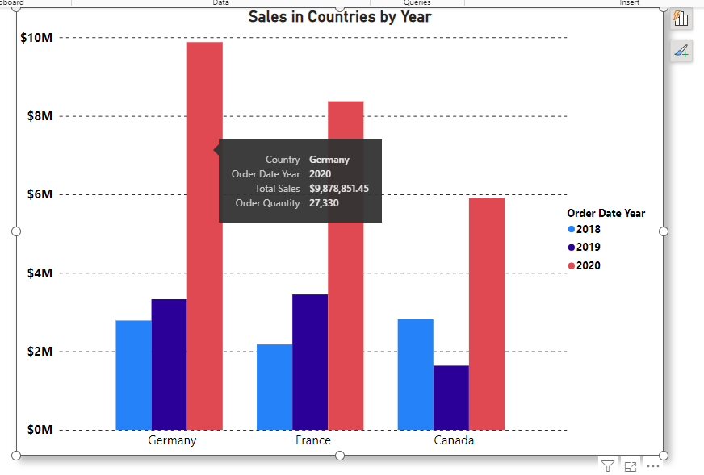
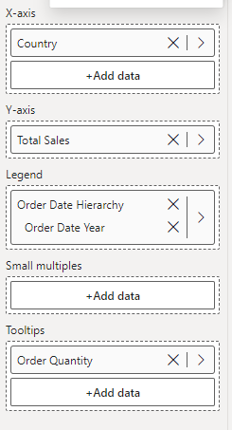
4 essential field wells in Column and Bar Charts:

Slide 44
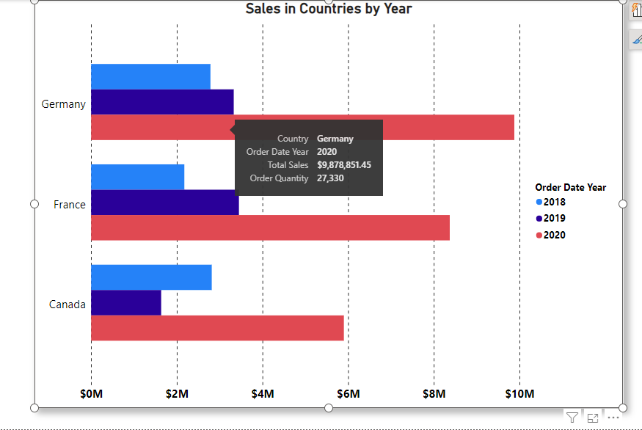
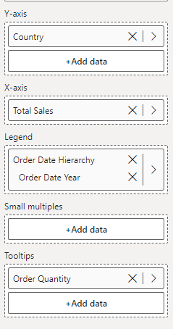
4 essential field wells in Column and Bar Charts:

Slide 45

Exercise 1:
Creating Column Charts

Slide 46
Exercise 2:
Creating Bar Charts

Slide 47

Question
Question
Which field determines the height of bars in a column chart in Microsoft Power BI?
A. X-axis
B. Legend
C. Tooltip
D. Y-axis

Slide 48
ANSWER
Question
Which field determines the height of bars in a column chart in Microsoft Power BI?
A. X-axis
B. Legend
C. Tooltip
D. Y-axis

Slide 49
4
Pie and Donut Charts

Slide 50
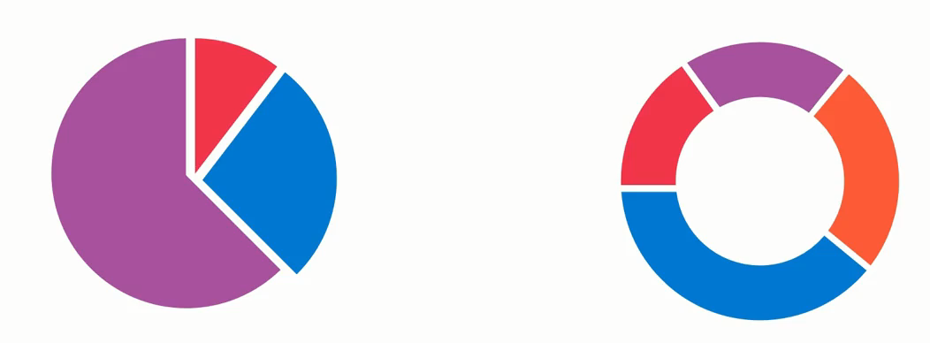
Pie and Donut Charts

Slide 51
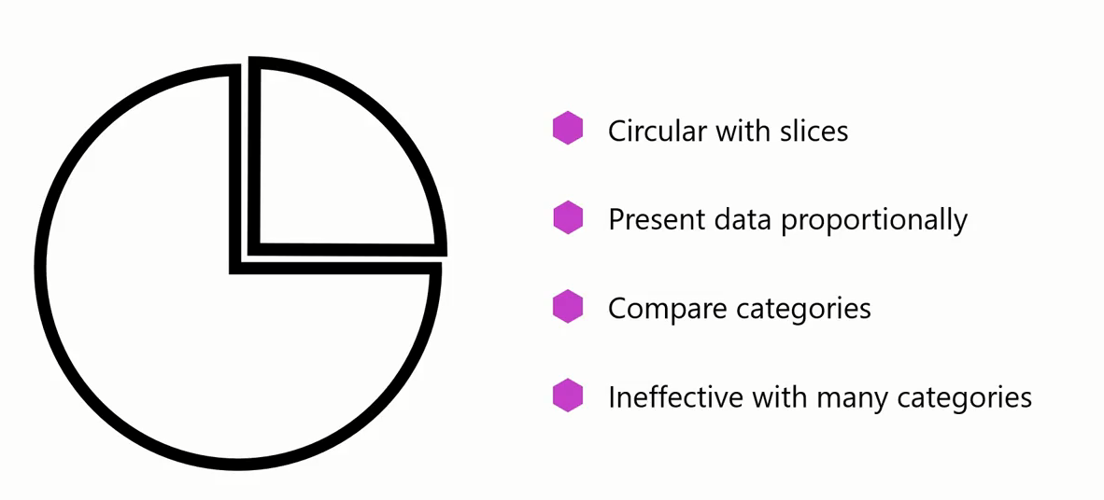
Pie and Donut Charts

Slide 52
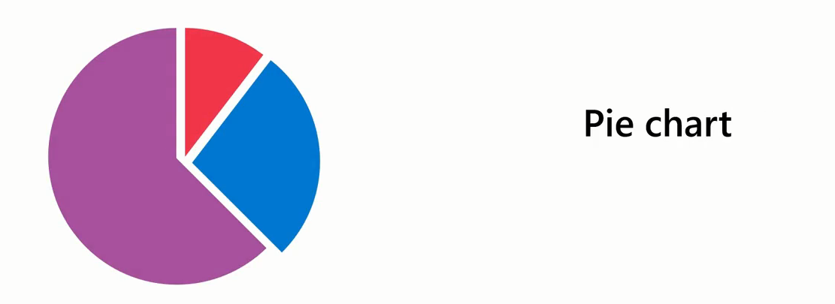
Pie and Donut Charts
In a pie chart, each slice of the pie corresponds to a unique category from your data set.
The size of each slice is directly proportional to the quantity it represents.

Slide 53
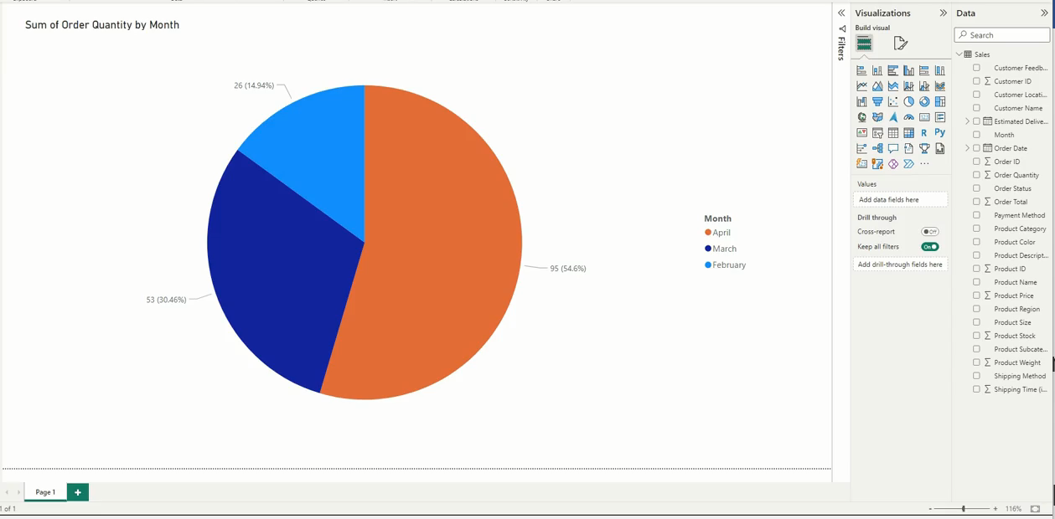
Pie and Donut Charts
Example: Sales in Months
The larger the slice the high sales in that month

Slide 54
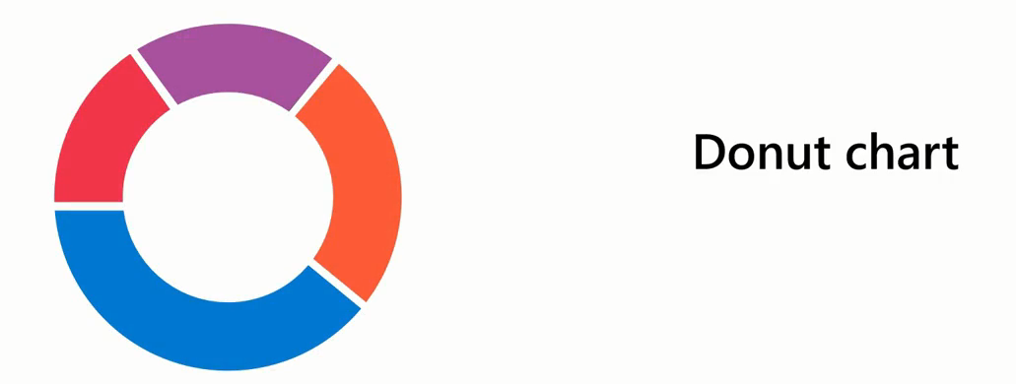
Pie and Donut Charts
The difference between a pie and a donut chart is that the donut chart is ring-shaped with a circular central space.
You can use this space to provide context for the surrounding segments.

Slide 55
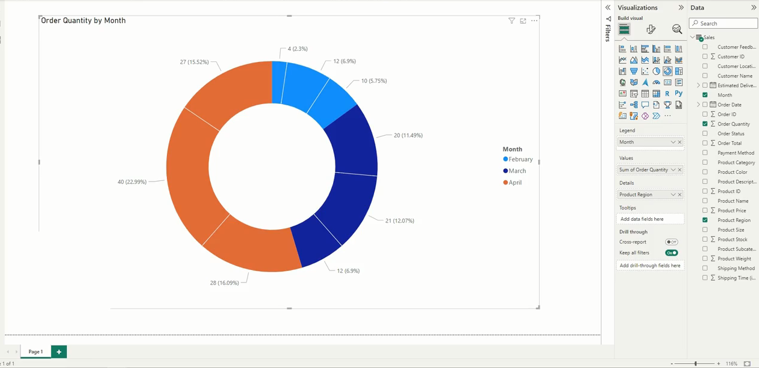
Pie and Donut Charts

Slide 56
Exercise 3:
Creating Pie and Donunt Charts

Slide 57
Question
What is the key difference between pie and donut charts in Microsoft Power BI?
A. Pie charts can represent a large number of data categories more effectively.
B. Unlike a pie chart, a donut chart can only represent a single category of data.
C. There is no difference between pie and donut charts.
D. A donut chart is like a pie chart with a hollowed-out center.

Slide 58
ANSWRER
What is the key difference between pie and donut charts in Microsoft Power BI?
A. Pie charts can represent a large number of data categories more effectively.
B. Unlike a pie chart, a donut chart can only represent a single category of data.
C. There is no difference between pie and donut charts.
D. A donut chart is like a pie chart with a hollowed-out center.

Slide 59
5
Line Charts

Slide 60
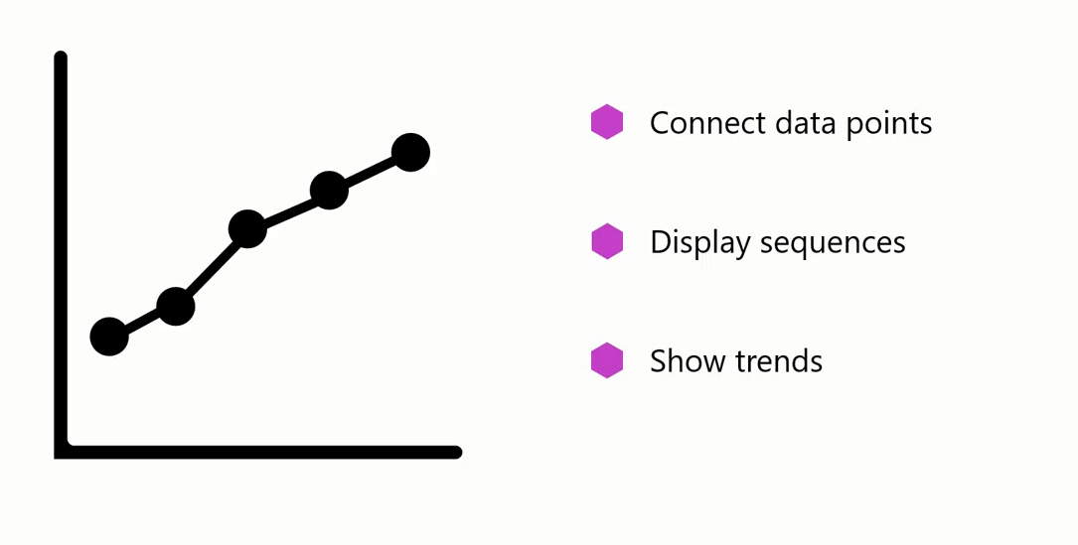
Line Chart

Slide 61
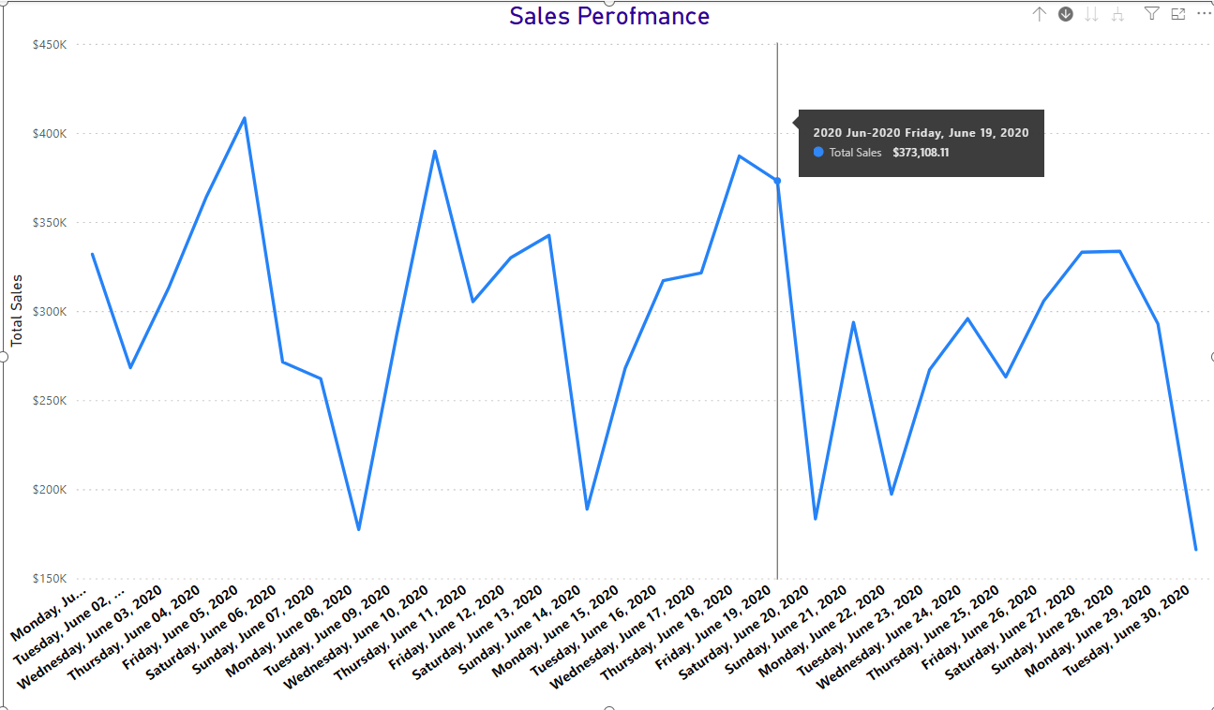
Line Chart
A line chart can help company understand how sales are progressing month to month or year to year.

Slide 62
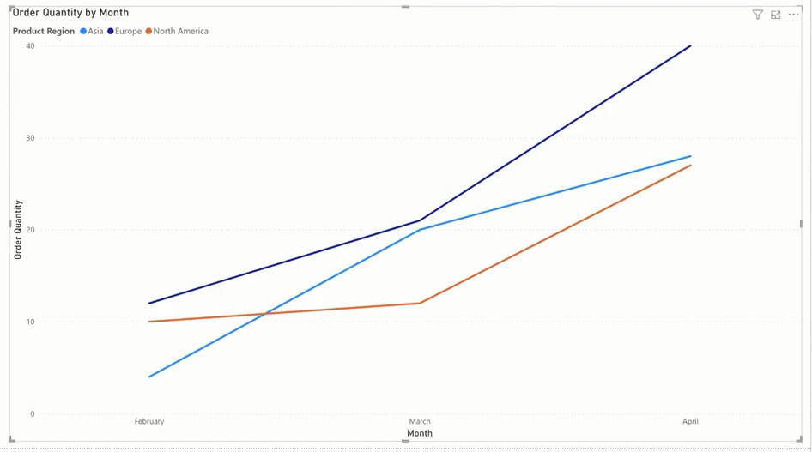
Line Chart
A line chart with multiple lines can show sales across different regions over time and help the stakeholders understand the trend or sales performance

Slide 63
Exercise 4:
Creating Line Chart

Slide 64
6
Area Chart

Slide 65

Area Chart
While a line chart focuses on trends, an area chart emphasizes the magnitude of changes.

Slide 66
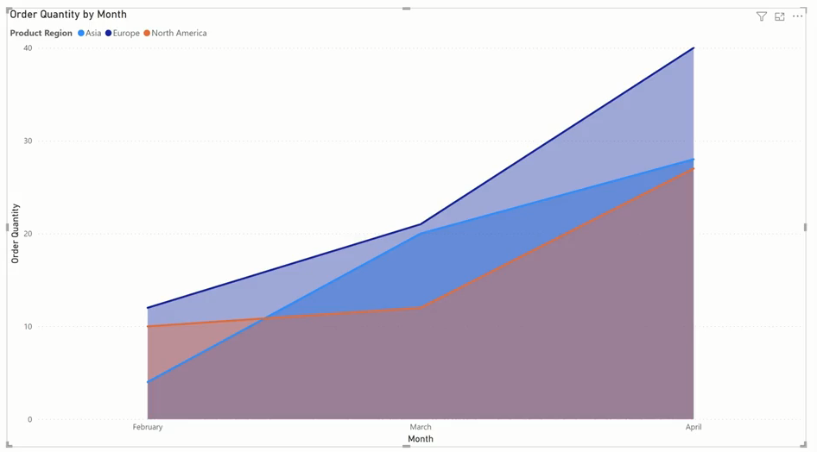
Area Chart
For example, regional sales represented by an area chart can help stakeholders intuitively understand and compare the degree each product region contributed to total sales for each month.

Slide 67
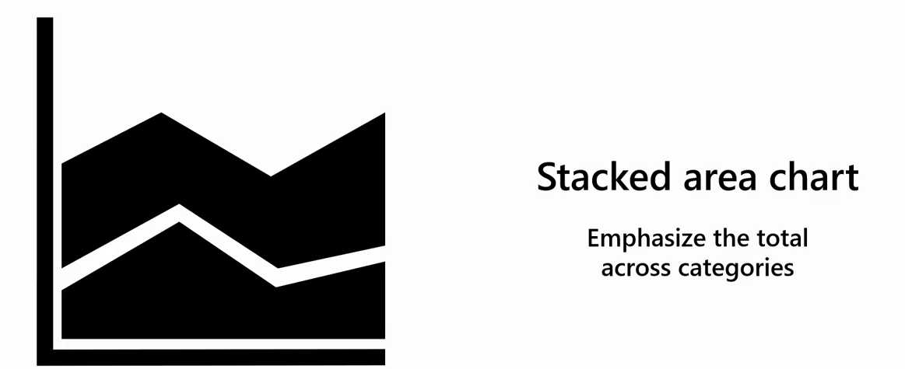
Area Chart
There's a variant of the area chart called a stacked area chart, where the data points from multiple categories are stacked on top of one another.

Slide 68

Area Chart
For example, you could use a stacked area chart to illustrate the total orders over a period and demonstrate how each product region contributes to the total.

Slide 69

Area Chart
100% Stacked Area Chart

Slide 70


when to use bar and column charts, or line and area charts?
When presenting a few items, bar and column charts can be visually appealing and effective.
When dealing with many data points, these charts can become cluttered and difficult to read

Slide 71

when to use bar and column charts, or line and area charts?
Area charts are effective for visualizing changes in multiple values over time.

Slide 72

when to use bar and column charts, or line and area charts?
Both line and area charts are effective in visualizing the changes in values of multiple categories, particularly over time.

Slide 73

when to use bar and column charts, or line and area charts?
Line charts are useful for identifying trends

Slide 74

When to use bar and column charts, or line and area charts?
Area charts offer a further benefit:
Interpret the magnitude of the values.
Effectively illustrate the cumulative impact of the data points over the selected time,
Providing an overall picture of the data trends.

Slide 75
Exercise 5:
Creating Area Chart

Slide 76
Question
In Microsoft Power BI, which chart type is more suitable if you want to highlight the trends rather than the quantity of your data over a period of time?
A. Column chart
B. Line chart
C. Pie chart
D. Area chart

Slide 77
ANSWER
In Microsoft Power BI, which chart type is more suitable if you want to highlight the trends rather than the quantity of your data over a period of time?
A. Column chart
B. Line chart
C. Pie chart
D. Area chart

Slide 78
7
Table Visualization

Slide 79

Table Visualization
Table visualization is useful when you want to employ the classic clear-cut style of tables to ensure your audience can grasp the essence of the data quickly.

Slide 80

Table Visualization
You can even customize the table visualization to improve its aesthetic appeal or aid engagement and comprehension.

Slide 81
Exercise 6:
Creating Table Visualization

Slide 82
Question
What happens when you select the column header in the table visual of Microsoft Power BI?
A. The data within that column is highlighted for editing.
B. The table visual's position on the report changes.
C. It opens a detailed view of the data within the column.
D. The column data is sorted in ascending order; selecting again sorts it in descending order.

Slide 83
ANSWER
What happens when you select the column header in the table visual of Microsoft Power BI?
A. The data within that column is highlighted for editing.
B. The table visual's position on the report changes.
C. It opens a detailed view of the data within the column.
D. The column data is sorted in ascending order; selecting again sorts it in descending order.

Slide 85
Question 1
You are creating a data analysis report for the sales department at Adventure Works exploring sales of different bicycle models over the past five years. What type of visualization is appropriate to clearly and effectively demonstrate trends in bicycle sales over time for stakeholders?
A. Pie charts
B. Column chart
C. Line charts
D. Bar charts

Slide 86

ANSWER 1
You are creating a data analysis report for the sales department at Adventure Works exploring sales of different bicycle models over the past five years. What type of visualization is appropriate to clearly and effectively demonstrate trends in bicycle sales over time for stakeholders?
A. Pie charts
B. Column chart
C. Line charts
D. Bar charts

Slide 87
Question 2
At Adventure Works, the financial department requires raw, detailed data and exact numbers of bicycle production quantities as part of its cost analysis and financial reporting and planning. Which visualization is best suited to presenting the production quantities in this scenario?
A. Pie charts
B. Tables
C. Line charts
D. Bar charts

Slide 88

ANSWER 2
At Adventure Works, the financial department requires raw, detailed data and exact numbers of bicycle production quantities as part of its cost analysis and financial reporting and planning. Which visualization is best suited to presenting the production quantities in this scenario?
A. Pie charts
B. Tables
C. Line charts
D. Bar charts

Slide 89
Question 3
As a Power BI data analyst, you need to create data analytics reports, including sales reports for businesses like Adventure Works. What purpose does the Visualizations pane serve in the analysis process?
A. To create, modify, and manage visual elements
B. To manage the data
C. To convert the data into text-based reports
D. To analyze the data

Slide 90
ANSWER 3
As a Power BI data analyst, you need to create data analytics reports, including sales reports for businesses like Adventure Works. What purpose does the Build pane serve in the analysis process?
A. To create, modify, and manage visual elements
B. To manage the data
C. To convert the data into text-based reports
D. To analyze the data

Slide 91
Question 4
The project manager at Adventure Works has been allocated a fixed budget for a new project. The funding is distributed across several categories: salaries, equipment, software, training, and miscellaneous expenses. You want to create a visual representation for the project manager that displays the proportion of the total budget that each category represents. What chart type is most suitable for this purpose?
A. Line
B. Pie
C. Bar
D. Area

Slide 92

ANSWER 4
The project manager at Adventure Works has been allocated a fixed budget for a new project. The funding is distributed across several categories: salaries, equipment, software, training, and miscellaneous expenses. You want to create a visual representation for the project manager that displays the proportion of the total budget that each category represents. What chart type is most suitable for this purpose?
A. Line
B. Pie
C. Bar
D. Area

Slide 93


